Slide 1

HUMAN RESOURCES DIVISION
HR USER GROUP
Tuesday 08 November
14:00 – 16:00

Slide 2

^{Agenda}
Introduction - John Parr
ECA update – Matt Thorne
MyHR – Jon Everard and John Pickering
DBS checks – Jodie Trumper
Right to work update – Jon Everard
Policy updates – Sarah Danzie
Wellbeing@UCL – Karen Smith
Any other business – John Parr (supported by HR colleagues)

Slide 3
ECA update
Matt Thorne
Interim Director of PECAPS

Slide 4
Temporary changes
Team performance management
Activity rather than departmental focus
Team structure inc temps
ECA
One communication channel
Separation of adverts from ECA

Slide 5
October
725
Changes
284 Leavers
601
Contracts
(59% increase on the same period last year)
672
Form 6
200 Honorary
109
Non Sip
A total of 2591 transactions in October 2016
(31% more than January 2016)

Slide 6
Going forward
All backlog cleared in November
December will be a ‘normal’ service
Review of service requirements from January
Oracle HR

Slide 7

MyHR
Jon Everard
Director of HR Systems Transformation Project (MyHR)

Slide 8

A reminder… Why change? Our Current Pain Points – feedback from the BPR Project…
There seems to be lots of unnecessary administration
Too many hand offs between different systems and users
The process aren't standard so things are done differently in each department
The systems don’t ‘talk’ to each other
Processes are over complex and not user friendly
Poor system functionality – the processes are inefficient and time consuming
It’s cumbersome, there are multiple approval steps and lack of accountability of exactly who does what
There’s lots of paperwork, form filling and checking
It takes ages to produce a report
Management Information is unreliable
Things seem to get lost in the system…
We need to train new people on multiple systems
There’s too much manual effort
There are numerous systems and I am expected to be able to work with all of them
I really need accurate reporting to make informed decisions

Slide 9


MyHR
What’s changing?
Service in Partnership
(SiP)
- Recruitment and contracting
- Leavers
- Honoraries & Affiliates
- Consultant Clinical Academics
- Changes – Appointments
- Changes – Payments & Allowances
- Changes – Absences
- Payments – Forms 6/7 and overtime
Outdated Systems
Re-engineered
Processes
Learning Electric Records System (LERS)
Resource Link
(RL)
HR, payroll and MyView
Simple
Streamlined
Standard
Best Practice
Core HR
Payroll
Manager & Employee Self Service
Training
Fully Integrated System
HR & Payroll
Processes

Slide 10
Go-Live
What does success look like?
A key enabler in UCL’s 2034 strategy is delivering excellent systems and processes in support of UCL’s vision:
A Single fully integrated HR management system through which all employee information can be viewed
Standard, streamlined and best practice processes and procedures
Simple, easy to follow policies and checklists
Reduced approvals, handoffs, duplication of manual work and non-added value activities
Reduction in manual processes and the overall administrative burden through process automation and system integration
An intuitive user experience that will drive user adoption and process compliance
Improved analytics to enable high quality and timely management information to inform decision making
Clear, unambiguous responsibility and accountability
Empowerment of managers and skilled users to make decisions aligned with policy and financial constraints
Full integration with MyFinance

Slide 11
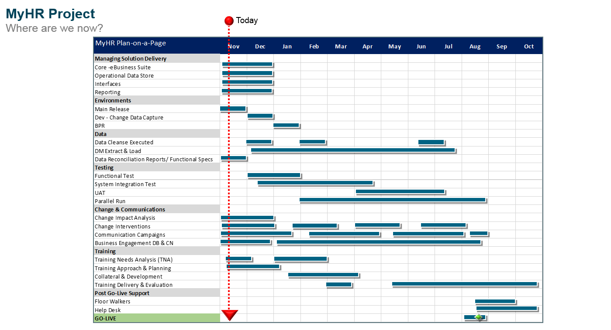

Slide 12


Slide 13
DBS Checks
Jodie Trumper
Acting Head of ECA

Slide 14
Work context | Responsibility for DBS check
A UCL employee who will be conducting regulated activity in UCL and another organisation under an honorary appointment | UCL must conduct the DBS check in advance, and they may also be required to have a separate check for their honorary appointment.
A prospective UCL employee who will only be conducting regulated activity as part of an honorary appointment with another organisation. | Honorary organisation will be required to carry out the DBS check. The honorary appointment must be in place before the employee starts work for UCL.
Where an individual has an honorary status with UCL and will be conducting regulated activity at UCL | UCL must conduct the DBS check
If an employee requires a DBS check to perform their role, this must be satisfactorily completed prior to them starting work.
This applies if the check is carried out by UCL or another employer, e.g. NHS trust.
Applicants must bring their certificate to UCL HR Reception or their departmental contact before they start work or, for existing employees, any project or new role involving regulated activity. This must be within 7 days of the date of issue of the certificate.

Slide 15
Right to work update
Jon Everard
Director of HR Systems Transformation Project

Slide 16
Policy Updates
Sarah Danzie
Head of Employment Policy and Governance

Slide 17

APPRAISALS
To ensure consistency across all UCL staff groups, all annual appraisals will move to an annual cycle from 2017
Ongoing meetings with Faculty Deans and FM’s have supported annual appraisals
Monitoring reports on appraisal completion rates will continue to be sent to departmental contacts and will switch to annual completion from 1 October 2017
Discussions ongoing and further information to follow in due course

Slide 18
R&S SECONDMENT POLICY
2 weeks of staff consultation closed on 31st October
Features of the new policy include:
  Creation of a recruitment checklist and chair’s guide to conducting recruitment
  New templates for interview notes
  Improved JD/PS template for consistency of style, aiding job matching
  Raised awareness of unconscious bias to support UCL’s equality aims
  Changes to advertising requirements and options for appointment following secondment, long-term acting up, or fixed term appointments to promote internal career development
  Positive action statement to consider part-time applicants
Next step to take back to HRPC in December 2016 with staff suggestions and proposal to implement early next year

Slide 19
CAPABILITY POLICY
Agreement reached with unions on most aspects of the revised policy and procedure
Fundamental disagreement with unions on the reduction of 3 formal stages to 2
Some concern about any link between appraisals and capability
Next step: JCNG and then all staff consultation

Slide 20
UKVI COMPLIANCE - Tier 4 Student Visas
Need to ensure UKVI compliance across UCL when working in different departments
Possible introduction of weekly timesheets. Still need to work through the operational practicalities and will arrange separate focus groups with DAs to talk through practical solutions and suggestions

Slide 21
UCL APPRENTICESHIP SCHEME
Apprenticeship briefing paper available in December 2016
Scheme launch in February 2017
Apprenticeship levy payable from May 2017
ISD piloting a trial scheme of 5 apprentices in January 2017

Slide 22

Wellbeing@UCL
UCL Wellbeing Strategy 2016 – 2021
Karen Smith
Wellbeing Consultant

Slide 23
Aims of this session
Introduce Wellbeing@UCL
Share the Six Pillars
Explain timeline
Next steps

Slide 24
Wellbeing@UCL – the documents
The strategy
Wellbeing policy
Wellbeing Champion role
Wellbeing Steering Group
Strategic Operating Plan
Branding

Slide 25

Aligning to UCL 2034 – A new 20-year strategy for UCL
Key enablers :
Giving our students the best support, facilities and opportunities.
Valuing our staff and delivering on equality and diversity.

Slide 26

The six pillars of Wellbeing@UCL
Positive environments
Embed in policies and practice
Reducing sedentary lifestyles
Mental wellness
Removing mental ill health stigma
Culture and behaviour change

Slide 27
Positive environments
Wellbeing Champions
Wellbeing Steering Group
Organisation Stress Risk Assessment
EDI networks
Aging workforce
Adaptive technology
Notes:
Working with EDI, student support and wellbeing, student disability services, Michelle Farmer disability co-ordinator
Networks

Slide 28
Embedding in policies and practices
Sodexo – choice and labelling
Leadership and management programmes
OD programmes and courses
Review accessibility of HR policies

Slide 29
Reducing sedentary lifestyles
Inactivity can be as bad for us as smoking
Getting people moving
Working with UCLU
Public Health Agenda
Proactive

Slide 30
Mental Wellness
Create online toolkits around resilience and stress
Promote 10 Minute mind – mindfulness
Mental health and suicide awareness training
Actively promote our EAP service

Slide 31
Removing mental ill health stigma
Create a Time to Change action plan
Aspirational statement
Sign the time to change pledge
Follow the action plan
Be visible
Share lived experiences

Slide 32
Culture and behaviour change
Health promotion
Signposting
Health and wellbeing awareness promotions
Wellbeing@UCL Website
Online and paper resources
Expert advisors
Workplace Wellbeing Charter

Slide 33

Timeline
Launch online – 1 December 2016
Launch Website – 8 December 2016
Physical launch – 16 January 2017

Slide 34
Next steps
Reaching out for Wellbeing Champions
Creating a wellbeing steering group
Communications through The Week@UCL
Development of Wellbeing Champions
Please share at you team meeting and with your colleagues

